Slide 1

Deep Learning Based Object Detection For Autonomous Drones
by
U. Varun
Roll No. 204G1A05C0
M. Uma
Roll No. 204G1A05B5
P. Srinath
Roll No. 214G5A0511
A. Srinivasa Sree Sharan
Roll No. 204G1A05A3
Under the guidance of
Mrs. G. Nagaleela M.Tech.
Assistant Professor
Department of Computer Science and Engineering
Srinivasa Ramanujan Institute of Technology
(Autonomous)
2023 - 2024
B-18
DEPT. OF COMPUTER SCIENCE AND ENGINEERING
SRINIVASA RAMANUJAN INSTITUTE OF TECHNOLOGY
1

Slide 2

Contents
Deep Learning Based Object Detection For Autonomous Drones
Comments
Abstract
Introduction
Literature Survey
Existing System
Proposed System
Planning
Design
Implementation
Research Paper
References

Slide 3
Comments
Deep Learning Based Object Detection For Autonomous Drones
Clarity about camera pixel?
Try to implement by drone?
Explain in detail about code?
Explain CNN Layers?

Slide 4
Abstract
Deep Learning Based Object Detection For Autonomous Drones
Object detection plays a vital role in enabling drones to perceive and interact intelligently with their surroundings. The process involves data collection, selecting appropriate deep learning architectures for accurate detection. In our proposed system, we explore the integration of advanced deep learning techniques into autonomous drones for object detection.
The trained models efficiently predict object presence in real-time imagery. The project aims to significantly improve the accuracy and reliability of object recognition, enabling drones to distinguish between different objects and navigate their environment with increased precision. The project's outcomes hold promising possibilities for enhancing drone applications in fields such as surveillance, search and rescue.

Slide 5
Inroduction
Deep Learning Based Object Detection For Autonomous Drones
The project aims to develop a system for autonomous drones capable of real-time object detection using deep learning algorithms.
Proposed system integrates a survey highlighting YOLOv3's exceptional accuracy in object detection
The YOLOv3 object detection algorithm is implemented on the ESP32, enabling the drone to identify and localize objects in its surroundings.
The system is optimized for real-time processing on the ESP32, ensuring rapid detection and response to objects in the drone's path.
The project demonstrates the integration of deep learning-based object detection with autonomous drone technology, showcasing the potential for intelligent and adaptive UAVs.

Slide 6
Literature Survey
Deep Learning Based Object Detection For Autonomous Drones
[1] Real-time object detection is crucial for many applications of Unmanned Aerial Vehicles (UAVs) such as reconnaissance and surveillance, search-and-rescue, and infrastructure inspection. In the last few years, Convolutional Neural Networks (CNNs) have emerged as a powerful class of models for recognizing image content.
Object detection based on CNNs is extremely computationally demanding, typically requiring high-end Graphics Processing Units (GPUs) that require too much power and weight, especially for a lightweight and low-cost drone . In this paper , they used Regions with CNNs (R-CNNs), a state-of-the-art algorithm, to detect different objects in near real-time.

Slide 7
Literature Survey
Deep Learning Based Object Detection For Autonomous Drones
[2] Unmanned aerial vehicle (UAV) has recently become a hotspot across the fields of computer vision (CV) and remote sensing (RS). Inspired by recent success of deep learning (DL), many advanced object detection and tracking approaches have been widely applied to various UAV-related tasks, such as environmental monitoring, precision agriculture, traffic management.
[3] Deep learning-based object detection solutions emerged from computer vision has captivated full attention in re-cent years. The primary objective of the paper is to provide a comprehensive review of the state of the art deep learning based object detection algorithms and analyze recent contributions of these algorithms to low altitude UAV datasets.

Slide 8
Existing System
Deep Learning Based Object Detection For Autonomous Drones
The existing systems for object detection in autonomous drones primarily rely on traditional computer vision techniques.
While effective for certain tasks and scenarios, these methods have limitations in adaptability, robustness, and real-time performance.
There is a need for advanced approaches that can handle diverse object categories, dynamic environments, and fast-changing scenarios.
Limitations of Traditional Methods:
These traditional methods rely heavily on handcrafted features and may not generalize well to diverse object categories.
They often require fine-tuning for different environments and object types, making them less adaptable to dynamic scenarios.
Real-time performance can be a challenge, especially in complex environments with multiple objects.

Slide 9
Existing System
Deep Learning Based Object Detection For Autonomous Drones
Challenges Faced by Existing Systems:
Limited adaptability to changing environments and varied object types.
Time-consuming fine-tuning and parameter adjustments for optimal performance.
Difficulty in handling occlusions, scale variations, and complex object shapes.
Suboptimal real-time performance, especially in scenarios with high-speed movement or crowded environments.
The introduction of deep learning-based methods, such as YOLOv3, holds promise for overcoming these limitations and enhancing the capabilities of autonomous drone systems.

Slide 10
Proposed System
Deep Learning Based Object Detection For Autonomous Drones
The proposed system aims to revolutionize object detection capabilities in autonomous drones by implementing state-of-the-art deep learning techniques. Specifically, the system plans to integrate the YOLOv3 (You Only Look Once) deep learning model, renowned for its exceptional accuracy and real-time performance, into the drone's processing pipeline.
Furthermore, the system aims to optimize the integration of YOLOv3 with the drone's onboard hardware, such as the ESP32 microcontroller, to ensure efficient processing and minimal latency. This optimization will enable the drone to perform object detection tasks seamlessly in real time, without compromising on performance or responsiveness.
Overall, the proposed system represents a significant advancement in autonomous drone technology, offering improved safety, efficiency, and adaptability in various applications.

Slide 11
Proposed System
Deep Learning Based Object Detection For Autonomous Drones
The proposed system contains the following facilities over the present system:
Integration of YOLOv3 Deep Learning Model
Real-Time Object Detection Capability
Enhanced Accuracy and Precision
Advantages:
High Accuracy Object Detection
Real-Time Processing Capability
Enhanced Safety for Autonomous Drones
Adaptability to Varying Lighting Conditions
Cost-Effective Implementation

Slide 12
Proposed System
Deep Learning Based Object Detection For Autonomous Drones
The objectives of this proposed system are
Implement YOLOv3 for Real-Time Object Detection
Enhance Autonomy and Decision-Making of Autonomous Drones
Improve Accuracy and Precision of Object Detection
Optimize Processing Efficiency on ESP32 Microcontroller

Slide 13
Planning
Deep Learning Based Object Detection For Autonomous Drones
Objectives
Develop a deep learning model that can accurately identify and classify various objects in real-time images captured by autonomous drones, enabling safer navigation.
Ensure that the object detection model runs efficiently on the limited computational resources of drones, enabling rapid decision-making and responsive actions in dynamic environments.
Performance
Object Detection Accuracy
Real-Time Processing Speed
Frame Rate for Video Processing
Detection and Recognition Time

Slide 14
Planning
Deep Learning Based Object Detection For Autonomous Drones
Functional Requirements
Implement YOLOv3 deep learning model for real-time object detection.
Accept input from the drone's camera or external sources for object detection.
Display detected objects with bounding boxes and labels on the user interface.
Integrate with drone control systems to adjust flight paths based on detected objects.
Non-Functional Requirements
Security
Reliability
Usability
Portability

Slide 15
Planning
Deep Learning Based Object Detection For Autonomous Drones
System Requirements:
Hardware Requirements:
System Processor : Intel I7
Hard Disk : 500 GB
Ram : 8 GB
Software Requirements:
Operating system : Windows OS 8.1
Coding Language : Python
IDE : VS code and Arduino IDE
GUI : IDLE Prompt

Slide 16
Planning
Deep Learning Based Object Detection For Autonomous Drones
Methodology:
This project uses Agile methodology. In that we use scrum agile methodology.
Scrum is characterized by cycles or stages of development, known as sprints.
It has four stages: Planning, Implementation, Testing and review.
Advantages:
This Methodology has ability to change and adapt with and satisfy the changing needs in short term.
Requires less documentation.

Slide 17
Planning
Deep Learning Based Object Detection For Autonomous Drones
Evaluate and select appropriate technologies for implementing the system, such as YOLOv3, ESP32 microcontroller, and drone APIs.
Design the system architecture, including modules, components, and their interactions.
Ensure scalability, flexibility, and modularity in the design.
Develop a comprehensive testing strategy, including unit testing, integration testing, and system testing.
Plan for testing scenarios to validate object detection accuracy, response time, and system reliability.
By including these elements, we can ensure a structured and organized approach to the development and implementation of the proposed deep learning-based object detection system for autonomous drones.

Slide 18
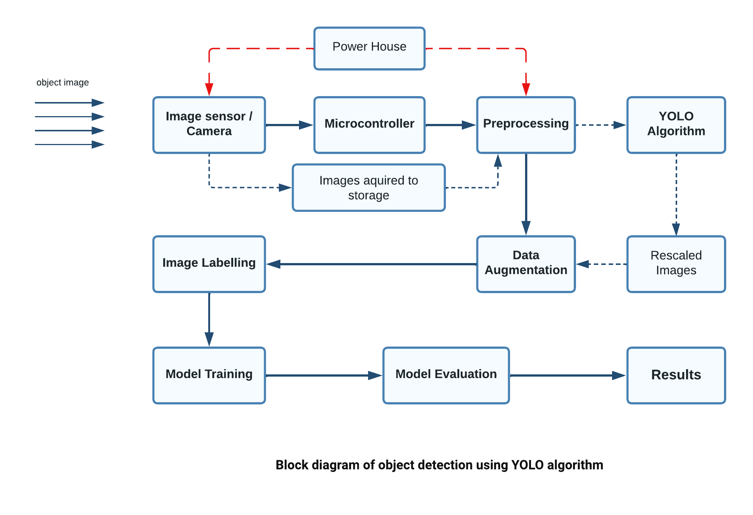
Design
Deep Learning Based Object Detection For Autonomous Drones

Slide 19

Implementation
Deep Learning Based Object Detection For Autonomous Drones

Slide 20

Implementation
Deep Learning Based Object Detection For Autonomous Drones

Slide 21

Implementation
Deep Learning Based Object Detection For Autonomous Drones

Slide 22
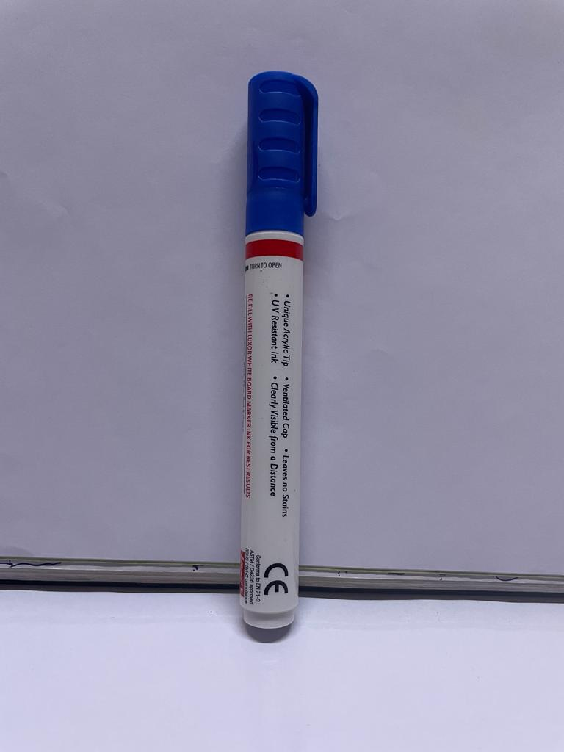
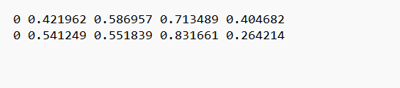
Implementation
Deep Learning Based Object Detection For Autonomous Drones
Fig1: Sample Trained Object and its data

Slide 23
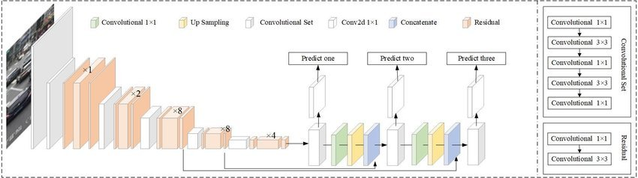
Implementation
Deep Learning Based Object Detection For Autonomous Drones
Fig 2: Architecture of YOLOV3

Slide 24
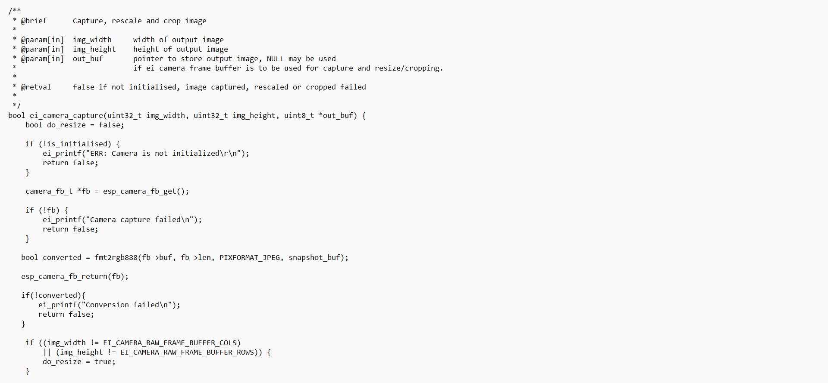
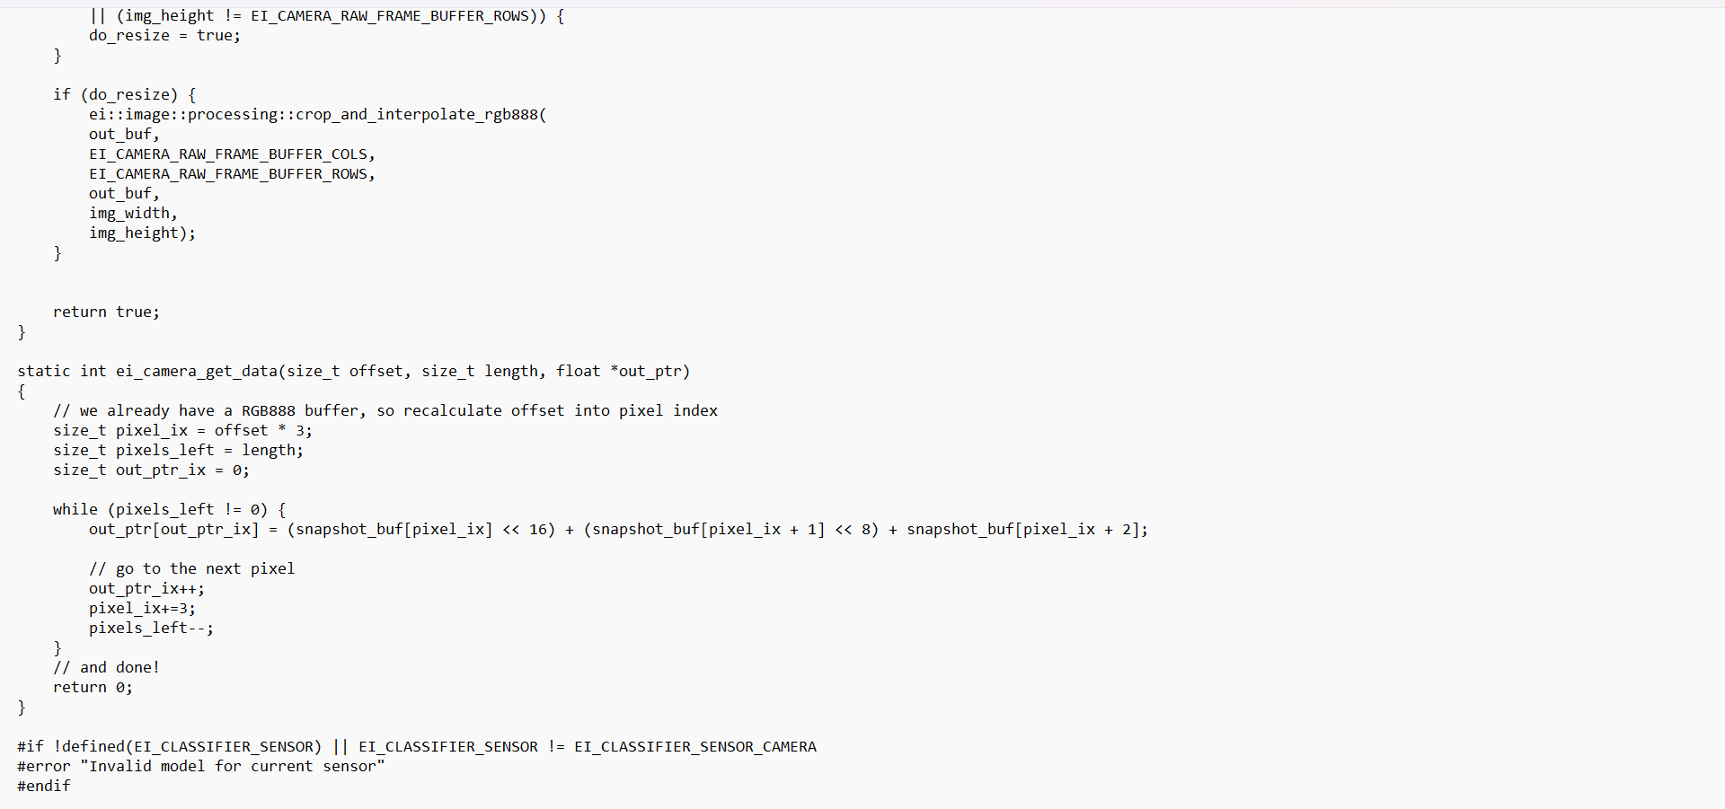
Implementation
Deep Learning Based Object Detection For Autonomous Drones

Slide 25
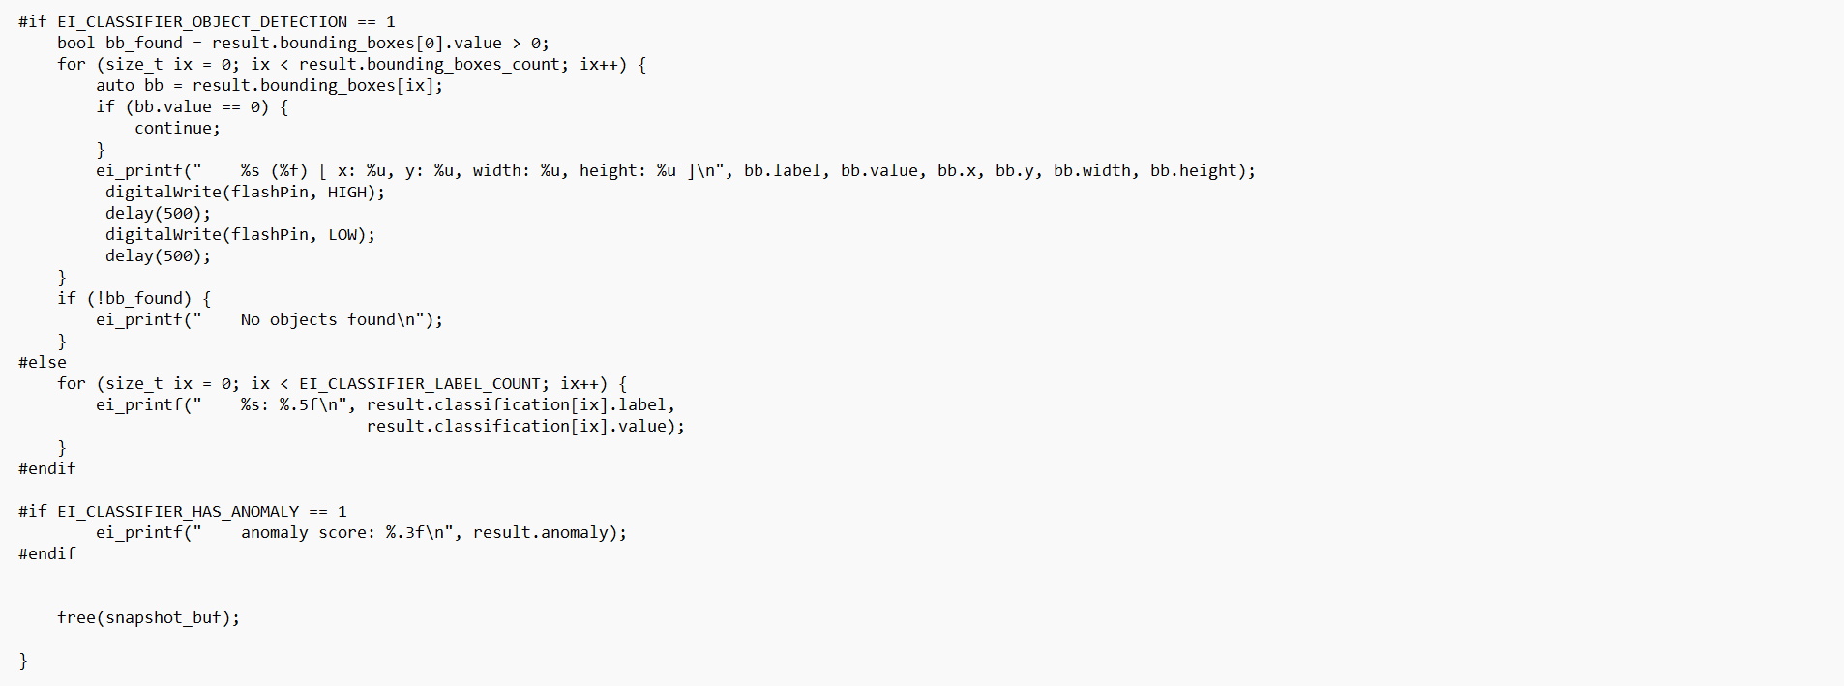
Implementation
Deep Learning Based Object Detection For Autonomous Drones

Slide 26
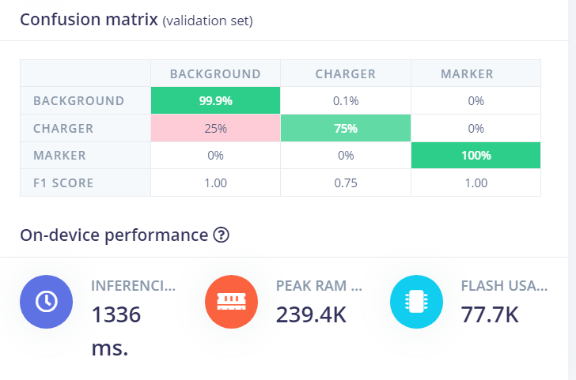
Implementation
Deep Learning Based Object Detection For Autonomous Drones
Fig 3: Confusion Matrix

Slide 27
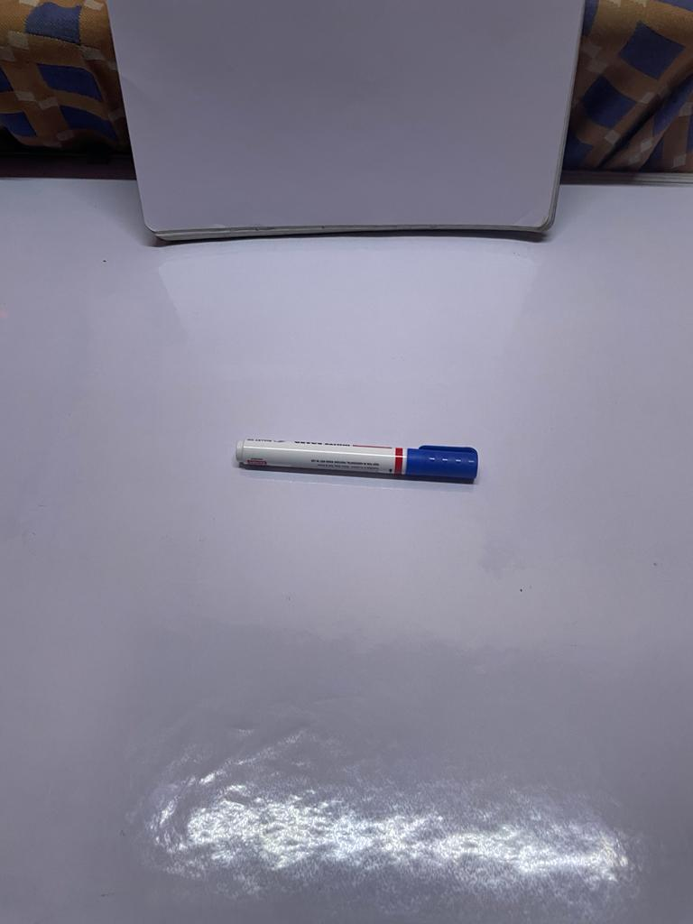
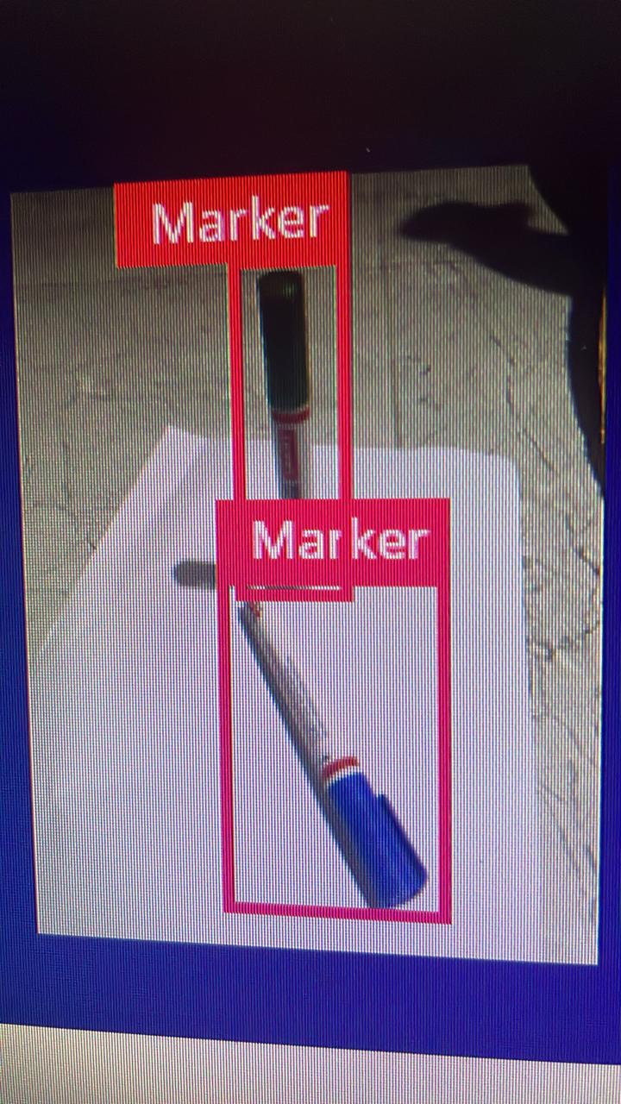
Implementation
Deep Learning Based Object Detection For Autonomous Drones
Fig 4: Trained Object
Fig 5: Predicted Object

Slide 28
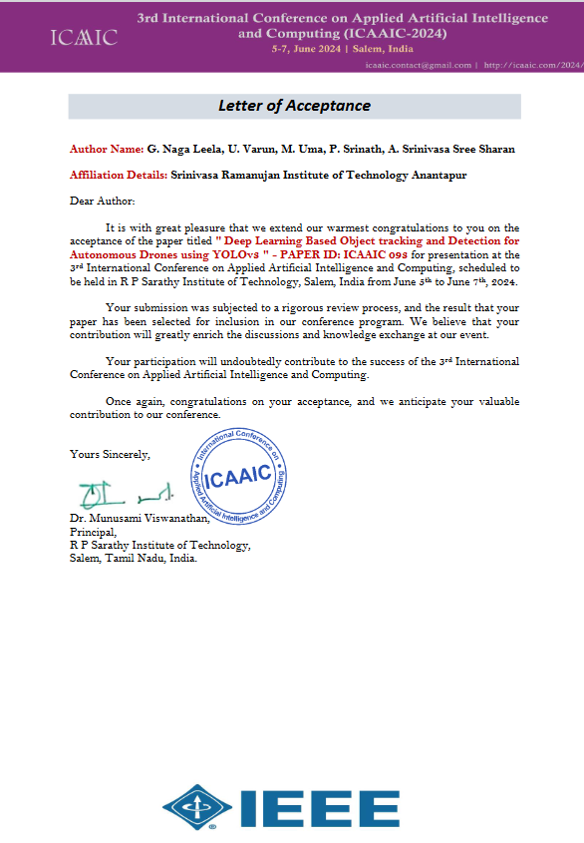
Research Paper
Deep Learning Based Object Detection For Autonomous Drones

Slide 29
References
Deep Learning Based Object Detection For Autonomous Drones
[1]. Jangwon Lee, Jingya Wang, David Crandall, Selma Sabanovi ˇ c, and Geoffrey Fox” Real-Time, Cloud-based Object Detection for Unmanned Aerial Vehicles”pp.8,2021.https://ieeexplore.ieee.org/document/7926512
[2]. Payal Mittal a , Raman Singh b , Akashdeep Sharma c, ⁎” Deep learning-based object detection in low-altitude UAV datasets: A survey”pp.1-13.https://deep_learning_based_object_detection_in.pdf
[3]. Xin Wu, Member, IEEE, Wei Li, Senior Member, IEEE, Danfeng Hong, Senior Member, IEEE, Ran Tao, Senior Member, IEEE, and Qian Du, Fellow, IEEE,” Deep Learning for UAV-based Object Detection and Tracking:ASurvey”pp.24,2021.https://arxiv.org/pdf/2110.12638

Slide 30
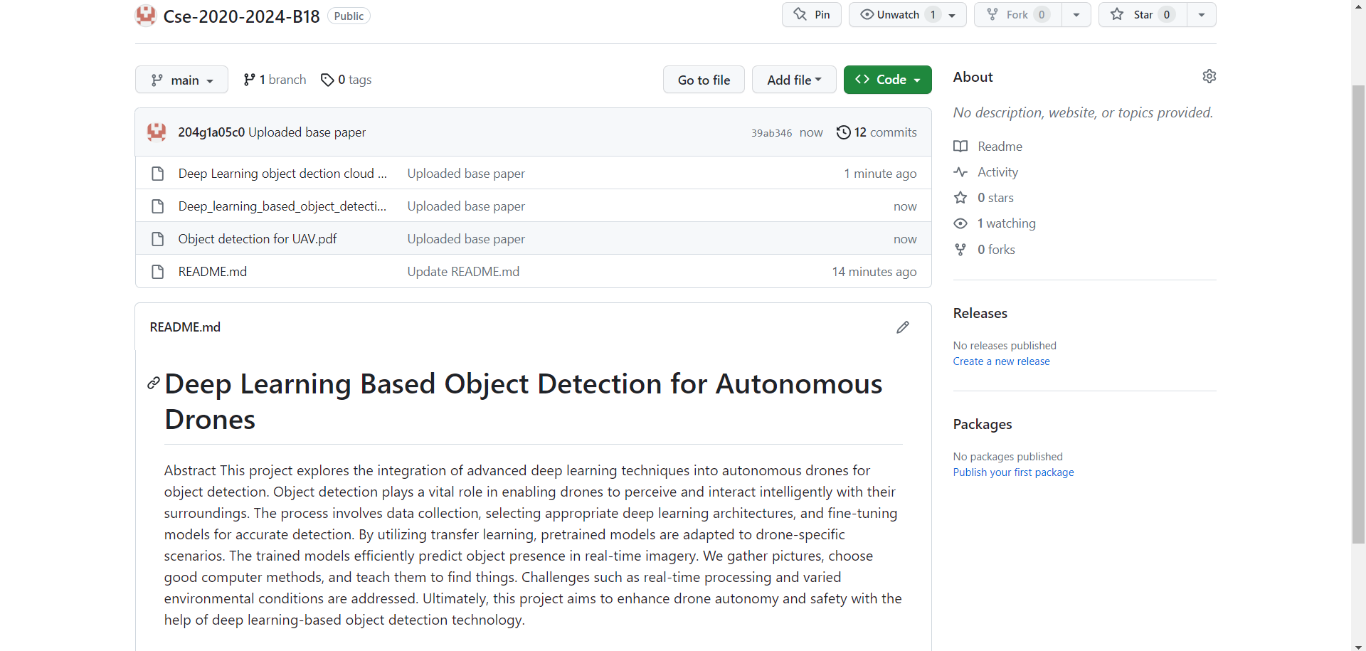
Git Hub Dashboards of Each Student
Deep Learning Based Object Detection For Autonomous Drones

Slide 31
Any Queries?

